Slide 1
Design and Implementation of a Small Scale Stand Alone Hybrid Solar PV and Wind Energy Generation
Team: Hussein Ghitan, Blaise Ronspies, Adam Schroeder, and Anna Schulte
Advisor/Client: Venkataramana Ajjarapu - Professor of Electrical Engineering
Team Website: https://sddec19-06.sd.ece.iastate.edu/ , Team Number: sddec19-06
Notes:
Explain why Ajjarapu is both our Advisor and Client

Slide 2
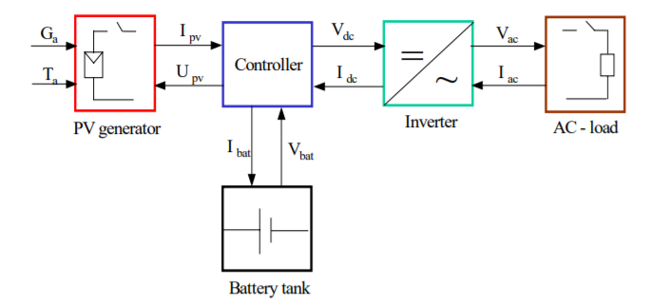
Introduction
Developing a PV stand-alone system for Electrical Engineering students, Power Electronics Class EE452
Solar Energy is the main source for photovoltaic systems
Generating direct and alternating current
Continuous work of 2017/2018 senior design teams
Notes:
The goal: to have a stand alone system with the solar panels being the main source
System made up of…..
PV generator: two solar panels
Battery tank: two 12V batteries
Controller: determined by the MPP, either
Load: Resistor bank to resemble a load
Inverter:

Slide 3
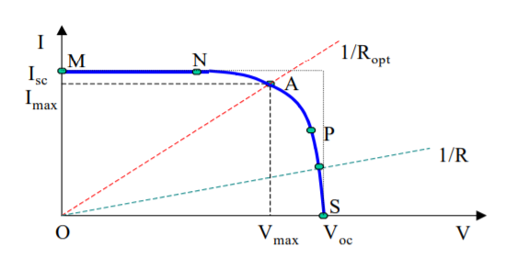
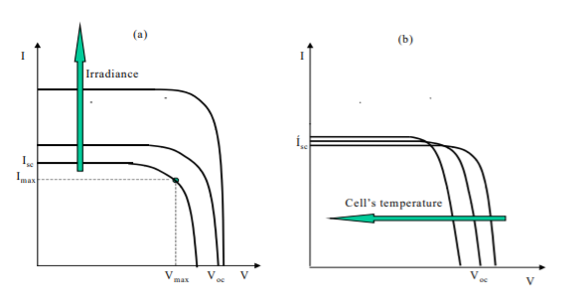
Introduction: Physics of PV System
Notes:
Deliverable that Ajjarapu wanted the students to understand when using the system in lab

Slide 4
Project Milestones
Fixed main breaker
Reengineered and implemented new power circuit
Created lab manual for simulation and hardware experiments
Ran EE 452 labs successfully
Notes:
Debugging circuits (Shorted circuits)
Explain the purpose of the lab manuals (deliverables for students)
Explain how lab went
Safety concerns - labeling, breaker for battery, insulation
Explain what needs to be done for AC circuitry

Slide 5
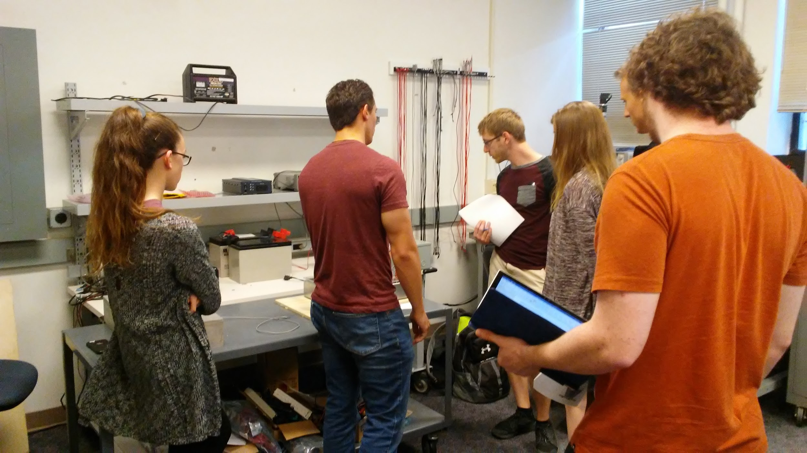
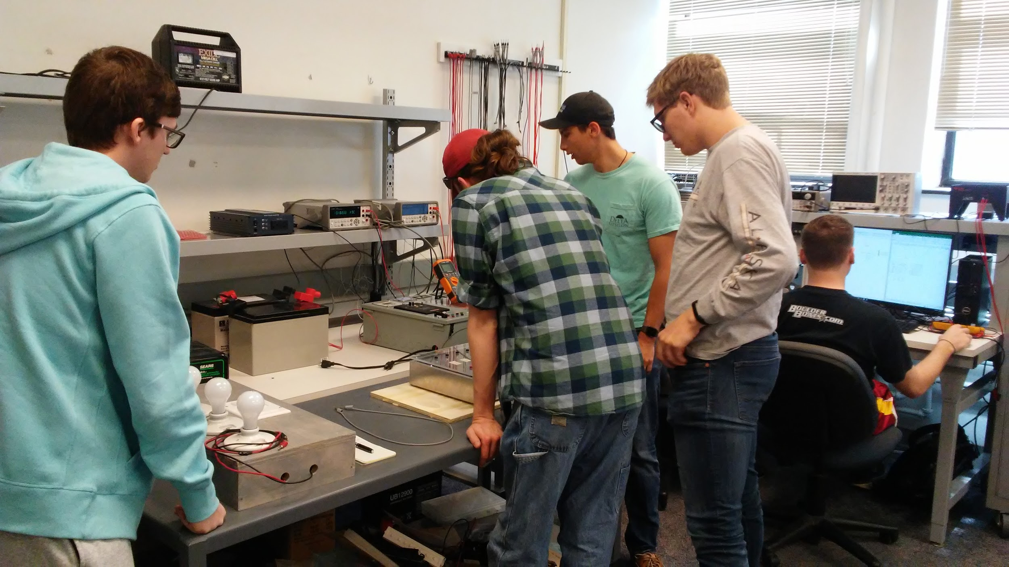
EE452 Lab Work

Slide 6
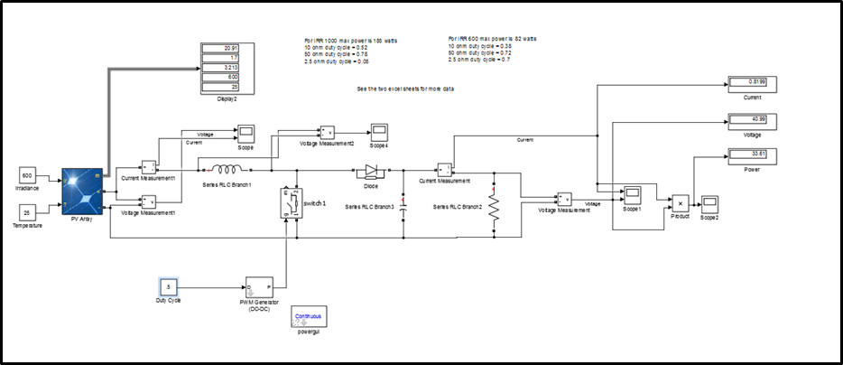
SOFTWARE: SIMULINK PV SYSTEM MODEL
Notes:
Hussein

Slide 7
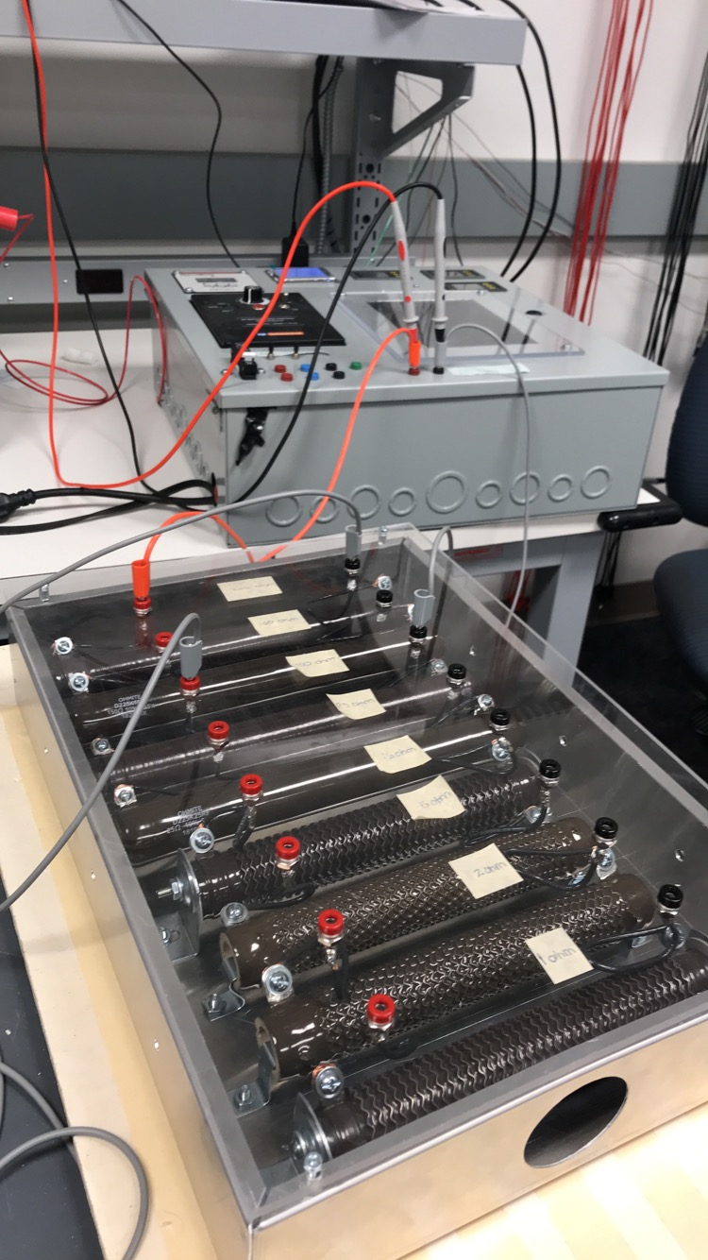
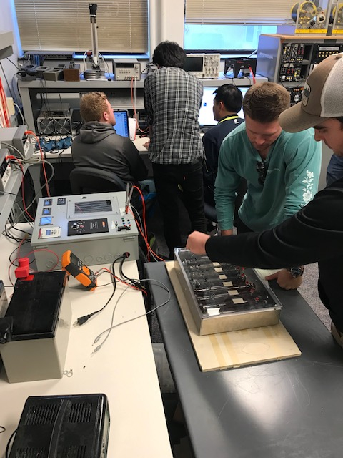
EE452 Lab Work

Slide 8
This Semester
Implement workable and safe layout of system:
Rework grounding for entire system
Label switches and displays
Redo lock to use a real key
Implement a clean and sensible workspace
Continue project schedule and additions:
Redo Arduino code for displays
Rework circuit as stand-alone
Implement A/C circuit
Notes:
Improve safety
Implement AC power circuit
Fix sensors and display circuit
Implement addition

Slide 9
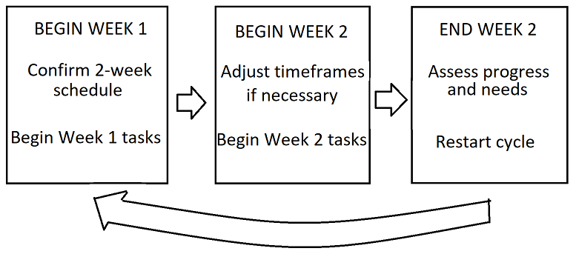
Project Schedule
Two-week Dev cycle
Goal 1: Displays
Semester Goal: All Labs Stand-Alone

Slide 10
Questions?

